Slide 1
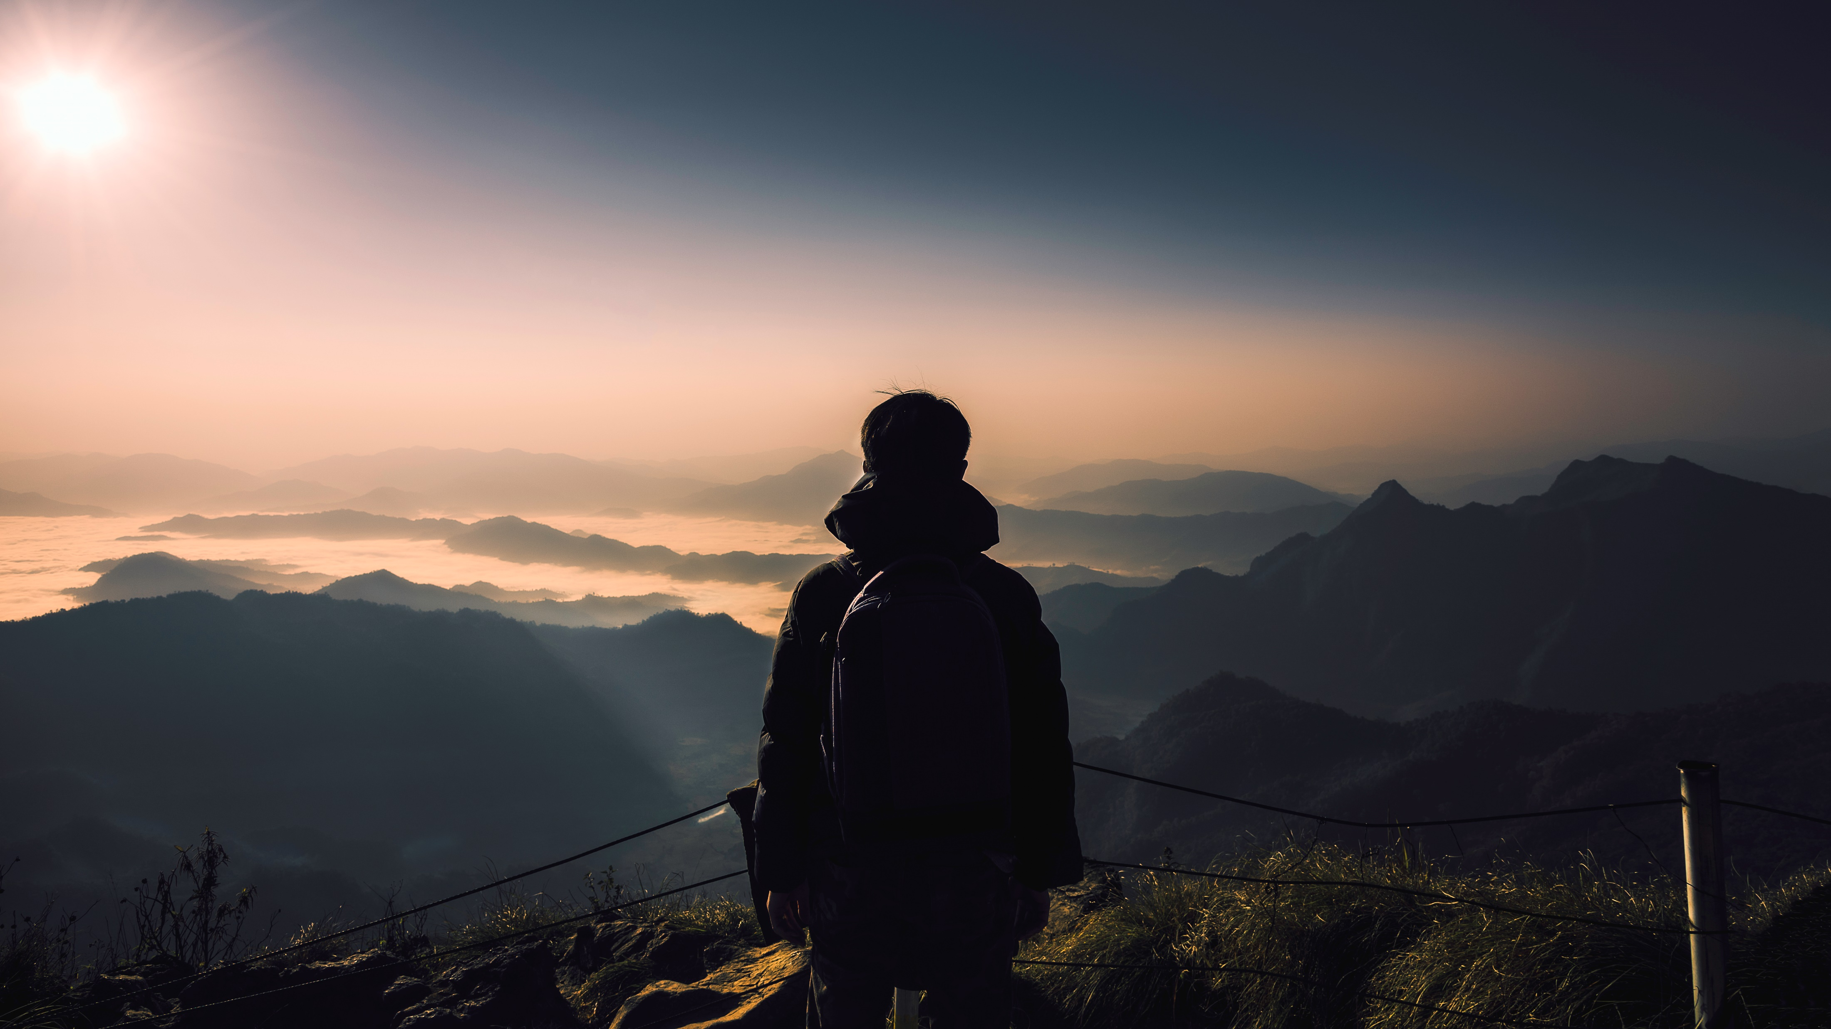
Travel motivation and the factor affecting the travel motivation
PRANUSHA ARYAL (2ND SEMESTER)

Slide 2
TRAVEL MOTIVATION
Travel motivation refers to the various factors, desires, or reasons that drive individuals to engage in travel and tourism activities. These motivations can vary widely from person to person and may include a range of factors such as the desire for relaxation, exploration, adventure, cultural experiences, social interaction, and more. Understanding travel motivation helps businesses in the travel and tourism industry cater to the diverse needs of travelers and create experiences that resonate with their interests and preferences.

Slide 3
FACTOR AFFECTING TRAVEL MOTIVATION
Personal Preferences:
Interests, hobbies, and individual preferences play a significant role. For example, someone interested in history may be motivated to visit historical sites.
Cultural and Social Influences:
Cultural background, family influences, and social circles can impact travel motivation. Family traditions, social trends, or recommendations from friends may influence travel decisions.
Work and Business Commitments:
Work-related factors, such as business trips, conferences, or career-related travel, can influence travel decisions.

Slide 4
Economic Considerations:
Financial factors, such as the cost of travel and available budget, can greatly impact travel decisions. Economic conditions and the affordability of destinations play a role.
Life Stage and Lifestyle:
Life events, such as weddings, graduations, or retirement, can influence travel decisions. Additionally, lifestyle choices, such as a preference for an active or leisurely lifestyle, play a role.
Psychological Factors:
Psychological needs and motivations, such as the desire for relaxation, adventure, or personal growth, can strongly influence travel decisions.

Slide 5
Technology and Information:
Access to information through technology, including online reviews, social media, and travel apps, can shape travel motivation by providing insights into destinations and experiences.
Special Events and Celebrations:
Special occasions, such as anniversaries, birthdays, or cultural celebrations, can be a motivating factor for travel.
In conclusion, travel motivation is a complex interplay of various factors that shape an individual's decision to embark on a journey. Personal preferences, cultural influences, economic considerations, psychological needs, and other elements contribute to the diverse motivations behind travel.

Slide 6



Make a Plan
Set a destination and/or travel theme
1
Set travel dates, mode of travel, and find accommodations
2
Find local attractions, food venues, and activities
3

Slide 7

Thank you

